Slide 1
Introduction

Slide 2





$$α$$
$$mg$$
$$R$$
$$θ$$
$$P$$

Slide 3
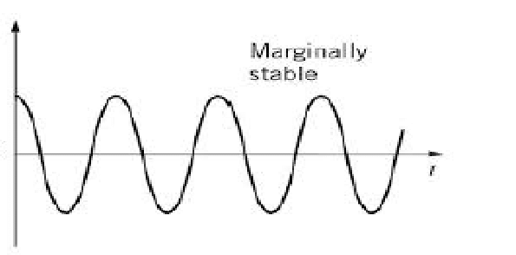



$$θ(t)$$
$$t$$

Slide 4
Hardware
Mechanical system: Drive motor, pendulum, flywheel, head servo, fabrication and materials
Electrical overview: PSoC Stick, RC receiver, MPU6050, DBH-12V motor driver, Pololu 12V DC Motor, goBilda servo, LM7805

Slide 5
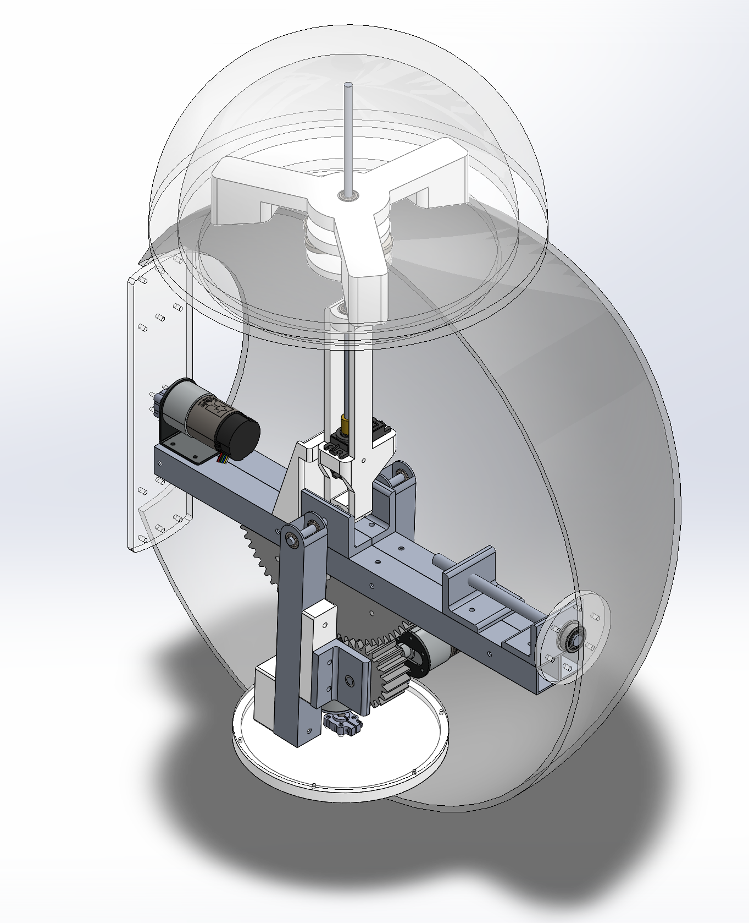
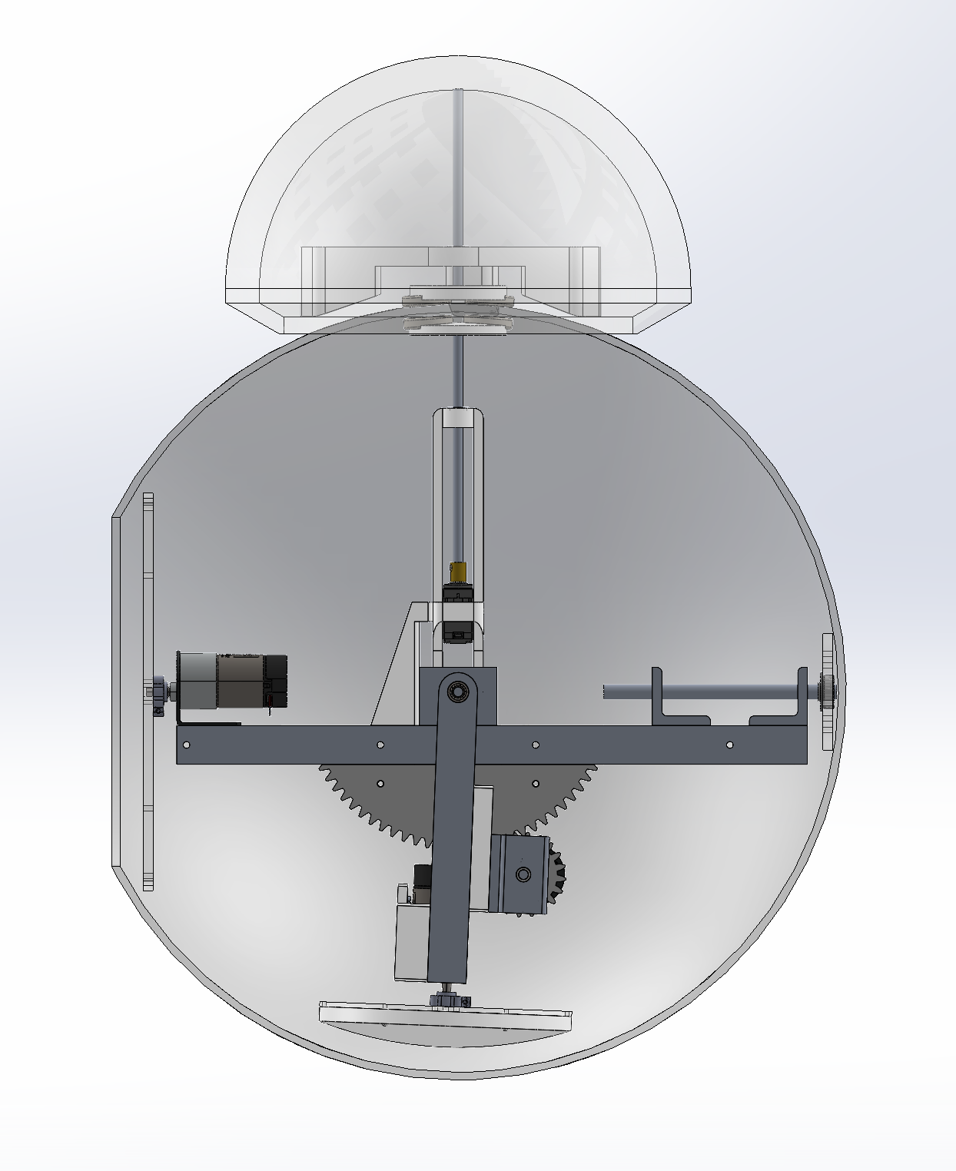



$$z$$
B
A
$$x$$
$$y$$
C

Slide 6
— Power
— Sensor I2C Input Data
— Encoder Digital Input Data
— Motor PWM Output Data
— RC Receiver PWM Input Data
MPU6050
Flysky RC Receiver
PSoC CY8C58LP
Pololu 131:1 37D 12V Gearmotor
DBH-12 Motor Driver
Pololu 50:1 37D 12V Gearmotor
goBilda 25-3 Speed Dual Mode Servo
DBH-12 Motor Driver
Pololu 19:1 37D 12V Gearmotor
12V NiMH Battery

Slide 7
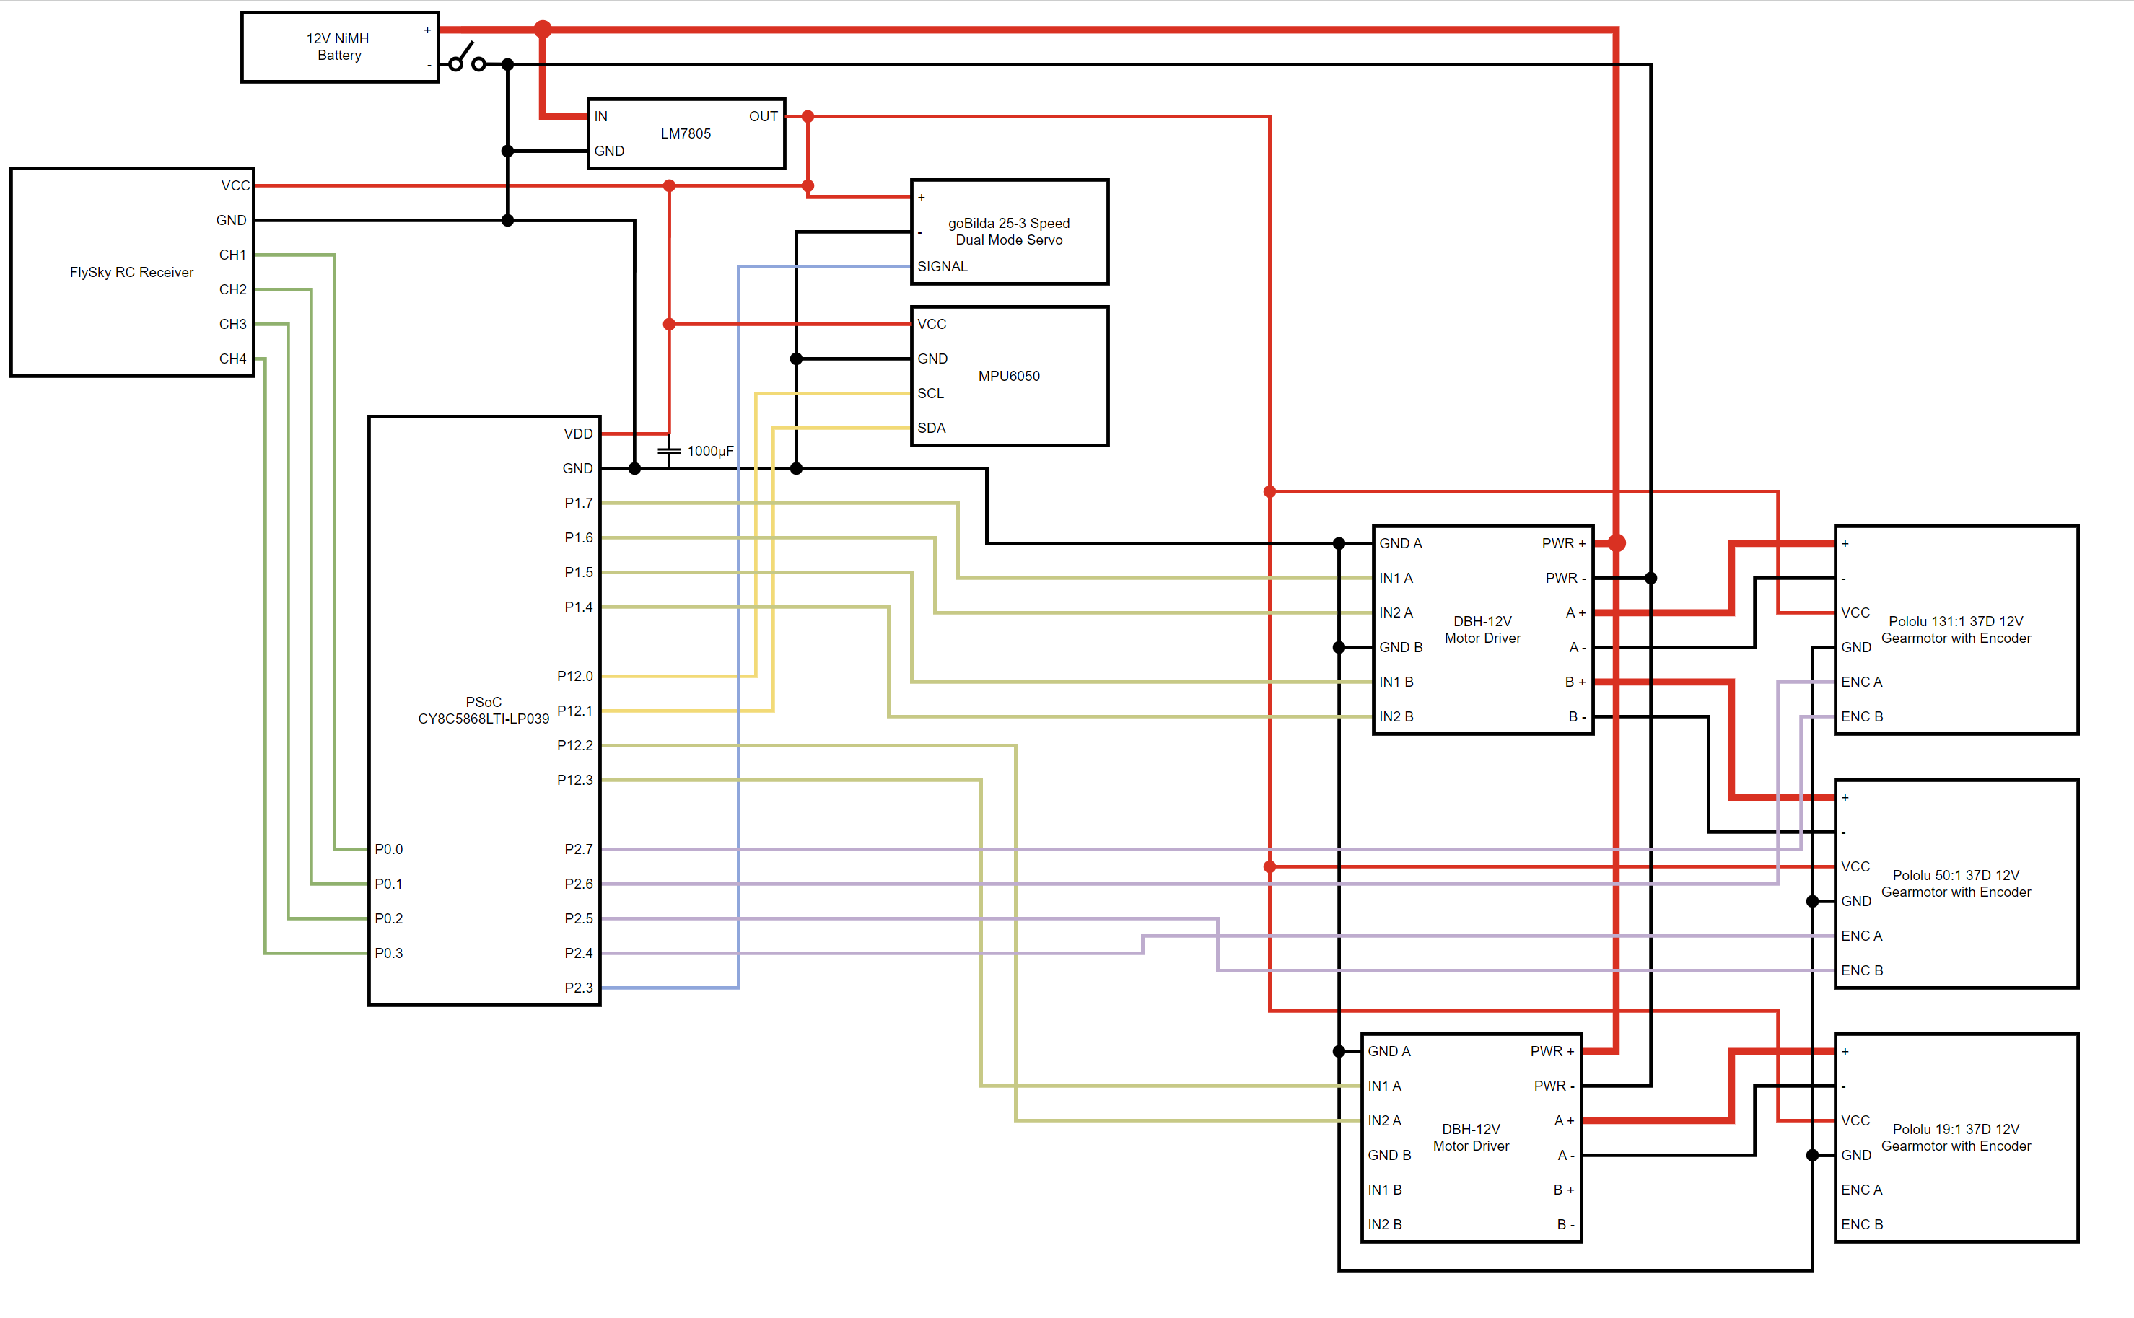

Slide 8
Software
Reading RC receiver data
Reading MPU6050 data
Writing to motors
Reading motor encoder data
PID control loops

Slide 9
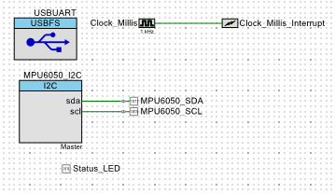
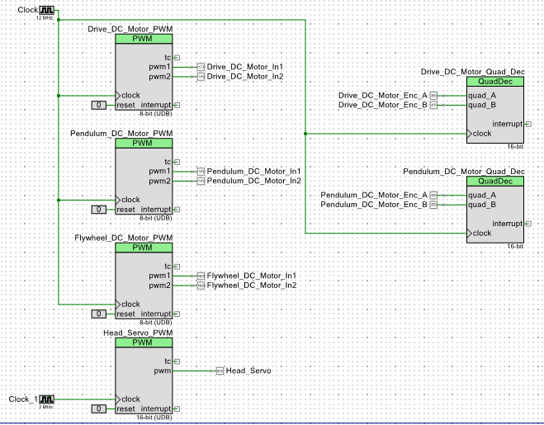
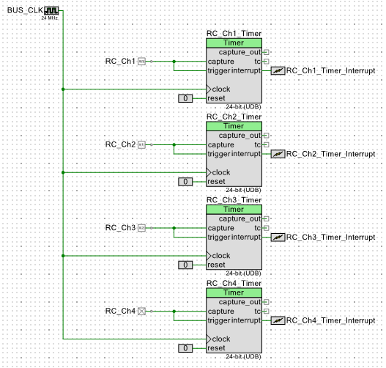

Slide 10
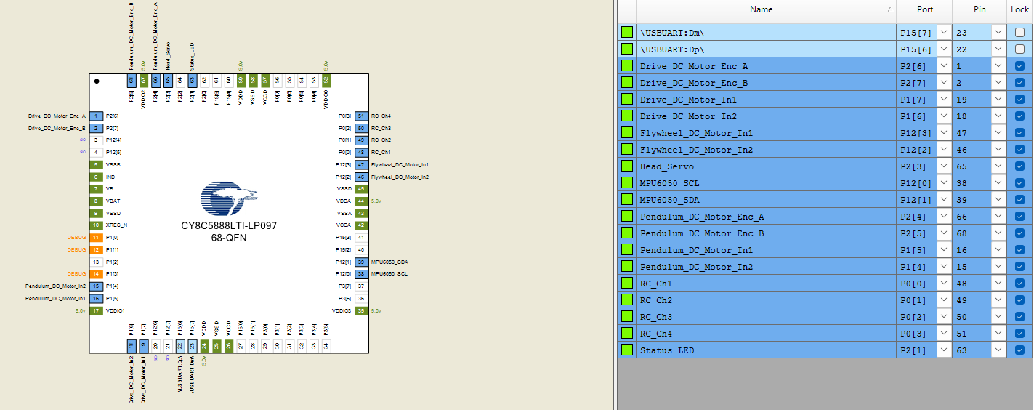

Slide 11
Read data from MPU6050
Flash status LED
1 meter traveled
Read data from RC Receiver Channels
Check drive motor encoder
1 meter not traveled
Stabilize ball with PID controller
Value is 0
Check RC Channel 2
Value is not 0
Run drive motor
Value is 0
Value is not 0
Run pendulum motor until pendulum encoder value reaches desired angle
Stabilize ball with PID controller
Check RC Channel 1
Stop flywheel motor
Value is 0
Check RC Channel 4
Value is not 0
Run flywheel motor
Stop head servo
Value is 0
Check RC Channel 3
Value is not 0
Run head servo

Slide 12
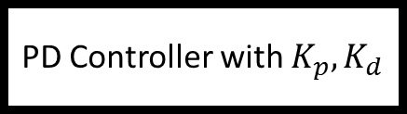
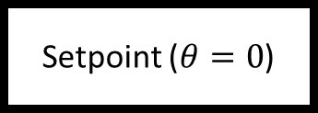

+
Setpoint ($θ=0$)
PD Controller with $K_{p}, K_{d}$
Motor PWM Output
-
IMU Data ($θ$)

